Slide 1



Menstrual Cups pilot study and current trial among schoolgirls in western Kenya
Penelope Phillips-Howard, on behalf of:
Kenya Medical Research Institute, Liverpool School of Tropical Medicine, Safe Water and AIDS Project, and US Centers for Disease Control-Kenya, in collaboration with Government of Kenya Partners
Funded by Joint Global Health trials (Medical Research Council; Department for international development; Wellcome Trust)

Slide 2

Background – importance of girls’ schooling
School is a ‘social vaccine’
Less HIV, STI, early marriage
If all girls graduate GNP > $3.2bn/y
Education predicts economic output
A quarter less girls graduate
Drop out ~50% teen pregnancy
Menstruation ~500,000 schooldays/m lost; ? dropout
What effect does menstrual-specific vs broader intervention have on adolescent girls’ sexual and reproductive health; school enrolment, retention, attainment (and at what cost)?

Slide 3
Background – effect of girls menstrual needs
Leaks, chaffing, smell, itching
‘Your thighs get irritated, you can’t even walk’ ; ‘you start itching it turns to a wound’ ‘it starts stinking makes people uncomfortable’ (girl)
Teasing, isolation, fearful, shame, stress
‘I always feel, you are lonely all the times’; ‘you become stressed up….how you will wash’ (girl)
Reduce class engagement, school physical activity
‘Your clothes will be blood stained...the teacher will see, hence you don’t concentrate’ (girl)
School absence during menses
‘They can absent themselves from school because of the materials …they get embarrassed’ (mother)
Economic considerations
‘You pay with your vagina’; ‘You need help, you just engage yourself into sex’ (girls). ‘She will look for this (money for pads) from the men, that is how they can end up with the unwanted pregnancies’ (parent).
Source: Mason et al ‘We keep it secret so no one should know’ – A qualitative study to explore young school girls attitudes and experiences with menstruation in rural western Kenya. PLoS ONE, 8(11):e79132, 2013

Slide 4
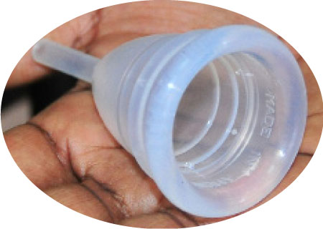
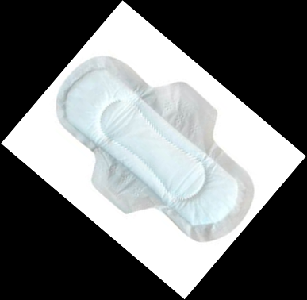

Pilot feasibility study on menstrual items (completed in Siaya County, western Kenya 2013)
Design 3-arm open cluster randomized controlled pilot
Measure unit School: randomization girls: assessment
Aim Examine acceptability, use, and safety
Location Rural primary schools w. Kenya
Target population Girls, 14 -16y, n=~750
Eligibility Consent, assent, 3+ menses
Duration Longitudinal 1 school year
Outcome School indices, SRH, wellbeing

Slide 5
The menstrual cup (Mooncup®)
Bell shaped vessel inserted into vagina to collect menstrual flow
Over 75 brands globally, includes Asian and African countries
Mooncup® - high grade medical silicone, hypoallergenic, FDA approved (303009117944), UK to ISO 13485:2003 standards
Train girls to hand-wash, insert, empty, clean (boil), store, not lend or sell
TSS in Canadian woman with Hashimoto thyroiditis (autoimmune disease)
Pilot: 7% replaced; drop in latrine, rat/burn damage; wrong size

Slide 6
Participant Flow Diagram
Assessed for eligibility (n=1005)
Participant exclusions (n=239)
♦ Declined participation (n=40)
♦ Non-eligible (n=199)
Enrolment
Eligible Participants (n=766)
Allocation
Usual
Pads
Cups
Total
Intervention Schools (10)
Participants (n=243)
♦ Received (n=239)
♦ Left preintervention (n=4)
Intervention Schools (10)
Participants (n=294)
♦ Received (n=288)
♦ Left preintervention (n=6)
Intervention Schools (10)
Participants (n=229)
♦ Received (n=224)
♦ Left preintervention (n=5)
Intervention Schools (30)
Participants (n=766)
♦ Received (n=751)
♦ Left preintervention (n=15)
Follow-Up
Participants (n=239)
Lost to follow-up (n=37)
♦ Withdrew (n=6)
♦ Migrated (n=31)
Participants (n=288)
Lost to follow-up (n=30)
♦ Withdrew (n=2)
♦ Migrated (n=28)
Participants (n=224)
Lost to follow-up (n=29)
♦ Withdrew (n=8)
♦ Migrated (n=21)
Participants (n=751)
Lost to follow-up (n=96)
♦ Withdrew (n=16)
♦ Migrated (n=80)
Analysis
Participants (n=202)
♦ Exclude pregnant pre- intervention (n=2)
ANALYSIS Usual (n=200)
Participants (n=258)
♦ Exclude pregnant pre-intervention (n=2)
ANALYSIS Pads (n=256)
Participants (n=195)
♦ Exclude pregnant pre-intervention (n=7)
ANALYSIS Cups (n=188)
Participants (n=655)
♦ Exclude pregnant pre-intervention (n=11)
ANALYSIS All (n=644)
Phillips-Howard PA et al, Menstrual cups and sanitary pads to reduce school attrition, and sexually transmitted and reproductive tract infections: A cluster randomised controlled feasibility study in rural western Kenya, BMJ Open; 6(11):e013229. 2016
Dropout endpoint (n=200)
STI/RTI endpoint (n=156)
Composite endpoint (n=172)
Dropout endpoint (n=256)
STI/RTI endpoint (n=202) Composite (n=228)
Dropout endpoint (n=188)
STI/RTI endpoint (n=144)
Composite (n=165)
Dropout endpoint (n=644)
STI/RTI endpoint (n=502)
Composite (n=565)

Slide 7
School / WASH findings affecting MHM
Av 10 (6-21) FT teachers/school; av 420 (154-1107) pupils/school
Pupil/teacher ratio mean 43:1 (15:1 – 75:1)
Mean 6 latrines/school for boys and same for girls
75% are pit-latrines; one third had lockable doors
Latrine to pupil ratio - mean 36:1 (GOK target 25:1)
86% of schools separated girls and boys latrine blocks
2% schools had observable soap for handwashing
66% of schools had observed water for handwashing
13% of schools had observed latrine cleaning materials
13% of schools had observed water for girls menstrual hygiene
10% gave sanitary pads to girls, 63% never and 23% sometimes
Source: Alexander et al Water, sanitation and hygiene conditions in Kenyan rural schools:
are schools meeting the needs of menstruating girls? Water, 6: 1453-1466, 2014

Slide 8
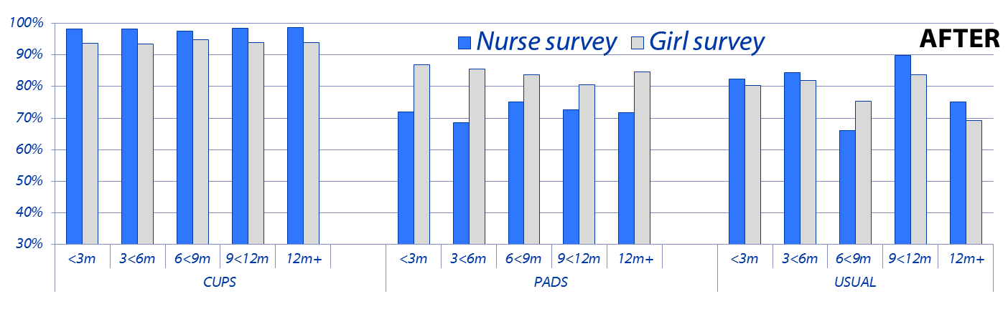
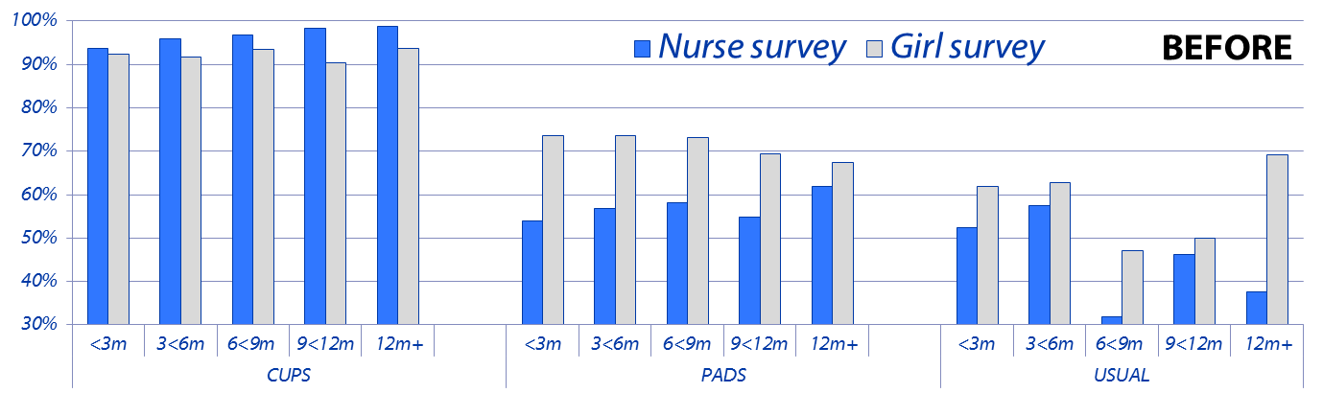
WASH - Reported 'always' handwash before/after change study duration: all menstrual groups
Source: Nyothach E, et al. Handwashing for menstrual hygiene management among primary schoolgirls in rural western Kenya. Waterlines, 34(4),279-295, 2015

Slide 9
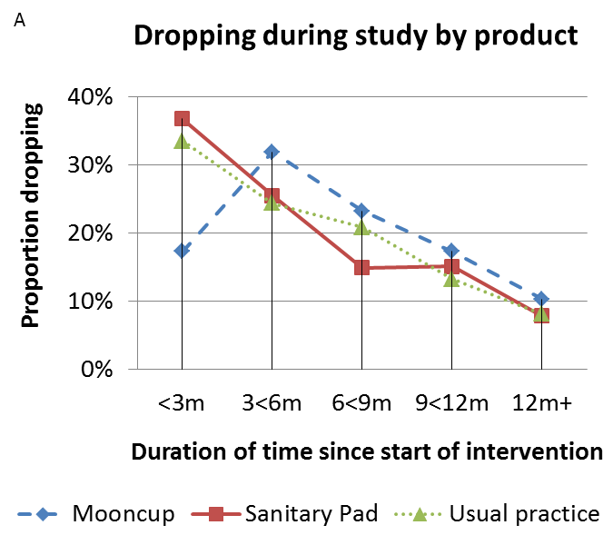
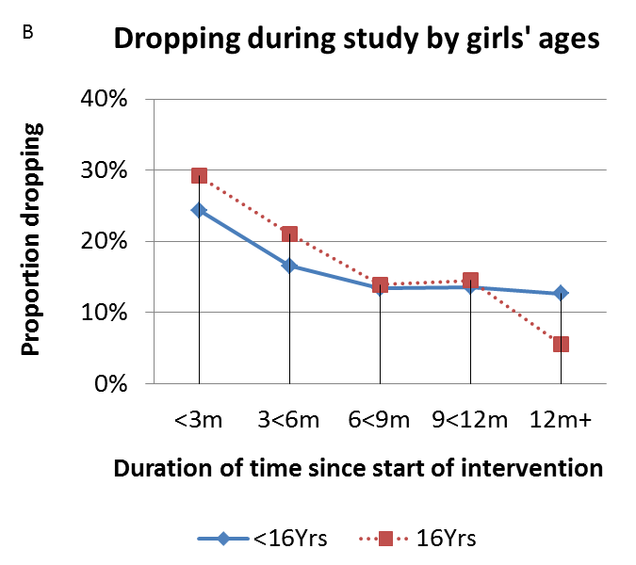
WASH and girls dropping of cups and pads
Average girl pupil-latrine ratio was 37:1 (range 11:1-70:1)
971 (17%) instances of accidental dropping of menstrual items
Younger girls dropping than older early in study …reversed longer term
Source: Oduor C, et al. Schoolgirls’ experiences of changing and disposal of menstrual hygiene items and inferences for WASH in schools. Waterlines, 34(4),397-411, 2015.

Slide 10
Schoolgirls’ feedback on effect of cups or pads
‘
Leaks, chaffing, smell, itching
‘I just come to school without fearing of leaking’ ; ‘you insert it you just go to school’ (girl)
Teasing, isolation, fearful, shame
‘I do not see her fearful like I used to notice before (mother)
Reduce class engagement, school physical activity
‘I’m feeling good because when I put that Mooncup inside I can run, I can do anything’ (girl)
School absence during menses
‘she is very free and does not absent herself from school like she used to before’ (mother)
Adapting to use
‘use it my daughter I don’t have money, will I be looking ..to buy maize or to buy pads’ (mother);
Economic considerations
‘since the Mooncup came, my mum is spending the money wisely sometimes if the fees is needed or even exam fees she can give me. Sometimes she gives me money to buy food at break time’ (girl)
Source: Mason L, et al Adolescent schoolgirls’ experiences of menstrual cups and pads in rural western Kenya: a qualitative study. Waterlines special MHM edition, 34:1; 2015

Slide 11
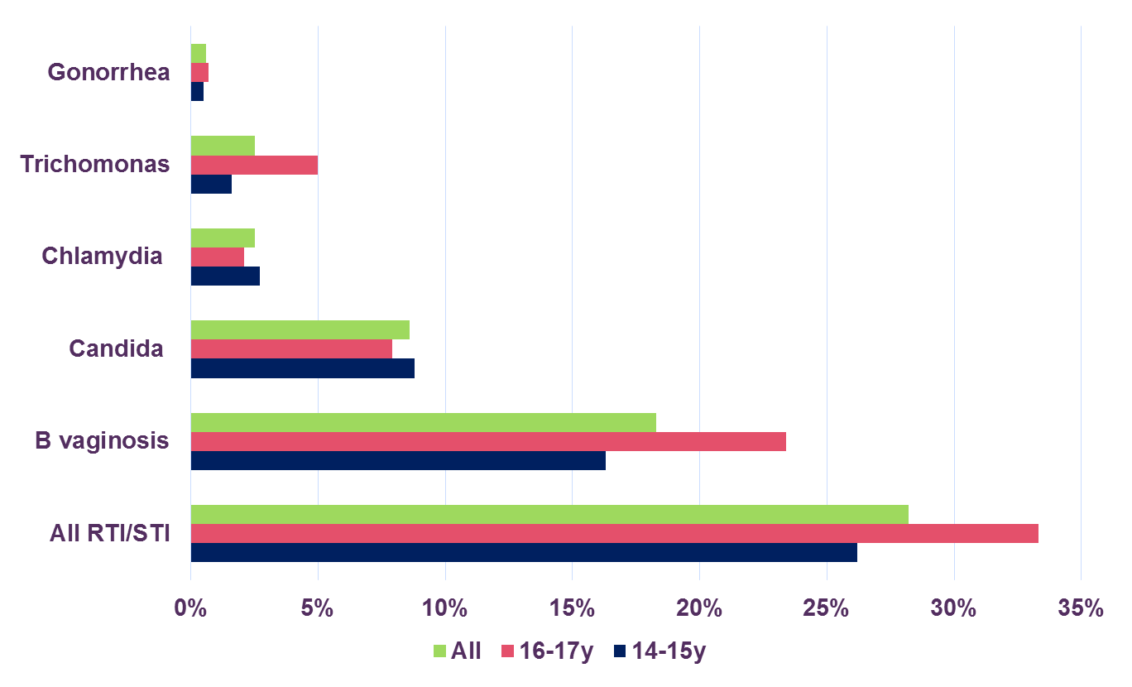
Prevalence of reproductive tract infections, including sexually acquired, among primary schoolgirls
Source: Kerubo E, et al. Prevalence of reproductive tract infections and the predictive value of girls’ symptom-based reporting: findings from a cross sectional survey in rural western Kenya. BMJ-Sex Transm Infect, 92(4):251-6, 2016.

Slide 12
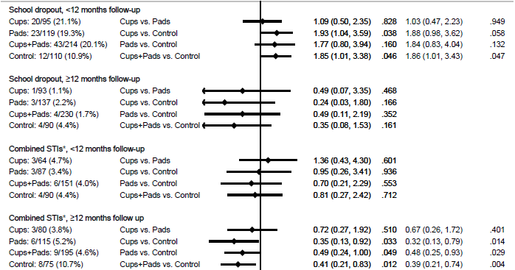
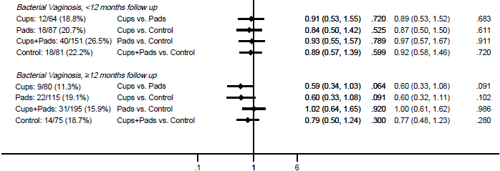
Effect of menstrual items on outcomes stratified by use (<12m>)
Phillips-Howard PA et al, Menstrual cups and sanitary pads to reduce school attrition, and sexually transmitted and reproductive tract infections: A cluster randomised controlled feasibility study in rural western Kenya, BMJ Open; 6(11):e013229. 2016

Slide 13
Safety issues with menstrual product use
Severe Events | Cups (n=188) | Pads (n=256) | Controls (n=200) | Total (n=644)
Deaths recorded through HDSS | 0 | 0 | 0 | 0
Participant identified to have symptoms of TSS | 0 | 0 | 0 | 0
Visited health facility for TSS; other harms | 0 | 0 | 0 | 0
Staph aureus and TSS toxin among positives | Cups (n=177) | Pads (n=214) | Controls (n=186) | Total (n=604)
Prevalence of staph aureus | 9.6% | 11.2% | 11.3% | 10.8%
Presence of TSST-1 in 2nd survey positives | 0/4 | 2/3 | 0/3 | 2/10
 | Number sampled | E coli growth prevalence (95% CI) in cups sampled
All cups sampled | 35 | 37.1% (21.1%-53.1%)
Cups from new users (less than 6 months) | 17 | 53% (29.3%-76.7%)
Cups from established users (6 months plus) | 18 | 22.2% (2.9%-41.1%)
Source: Juma J, et al, Examining the safety of the menstrual cup provided to rural primary school girls in Western Kenya, BMJ Open, :e015429, 2017

Slide 14


Slide 15
METHODOLOGY: CUPS OR CASH FOR GIRLS TRIAL
4-arm cluster randomised controlled trial design
Adolescent girls in 84 secondary schools, Siaya County
Inclusion: Girls, local residents, attend secondary day school, reach menarche, parent consent, girls assent
Stakeholders randomization (cups, cash, cups+cash, contrl)
Parent consent, girls assent: trial, HIV/HSV2 test, store blood
Enrolment/baseline survey: demographic, social, sexual risk behaviors; plasma samples obtained for HIV and HSV-2
HIV: serial testing (determine, unigold, ELISA(bioRad) tie-break
HSV-2: Herpes Simplex Type 2 IgG ELISA (Kalon)
Analysis: examine associations between HIV, HSV-2 with age, sexual activity, and other risk factors at baseline
Source: Zulaika G, et al. Study Protocol: Menstrual cups and cash transfer to reduce sexual and reproductive harm and school dropout in adolescent schoolgirls: protocol summary for a cluster randomised controlled trial in western Kenya

Slide 16
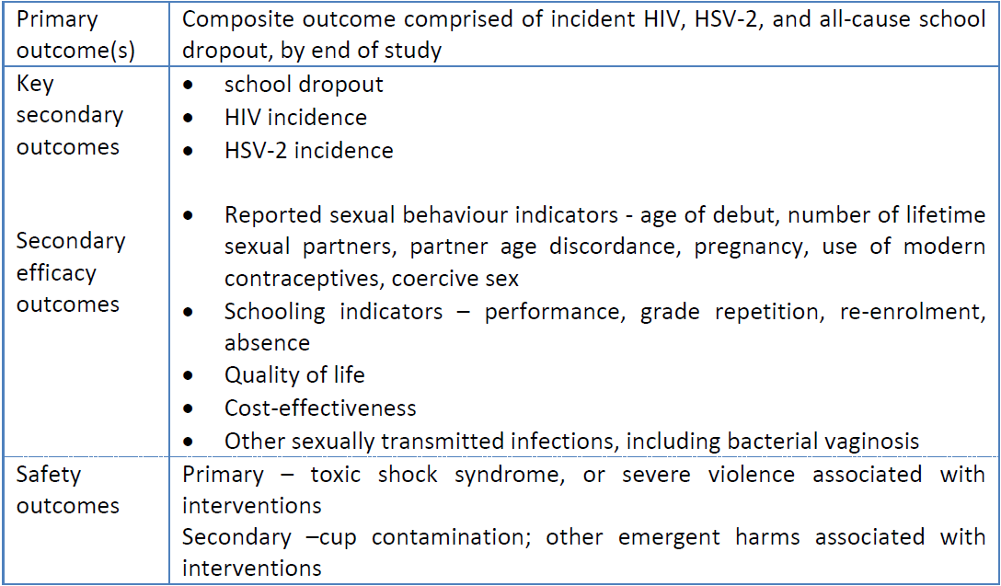
Key outcome indicators

Slide 17
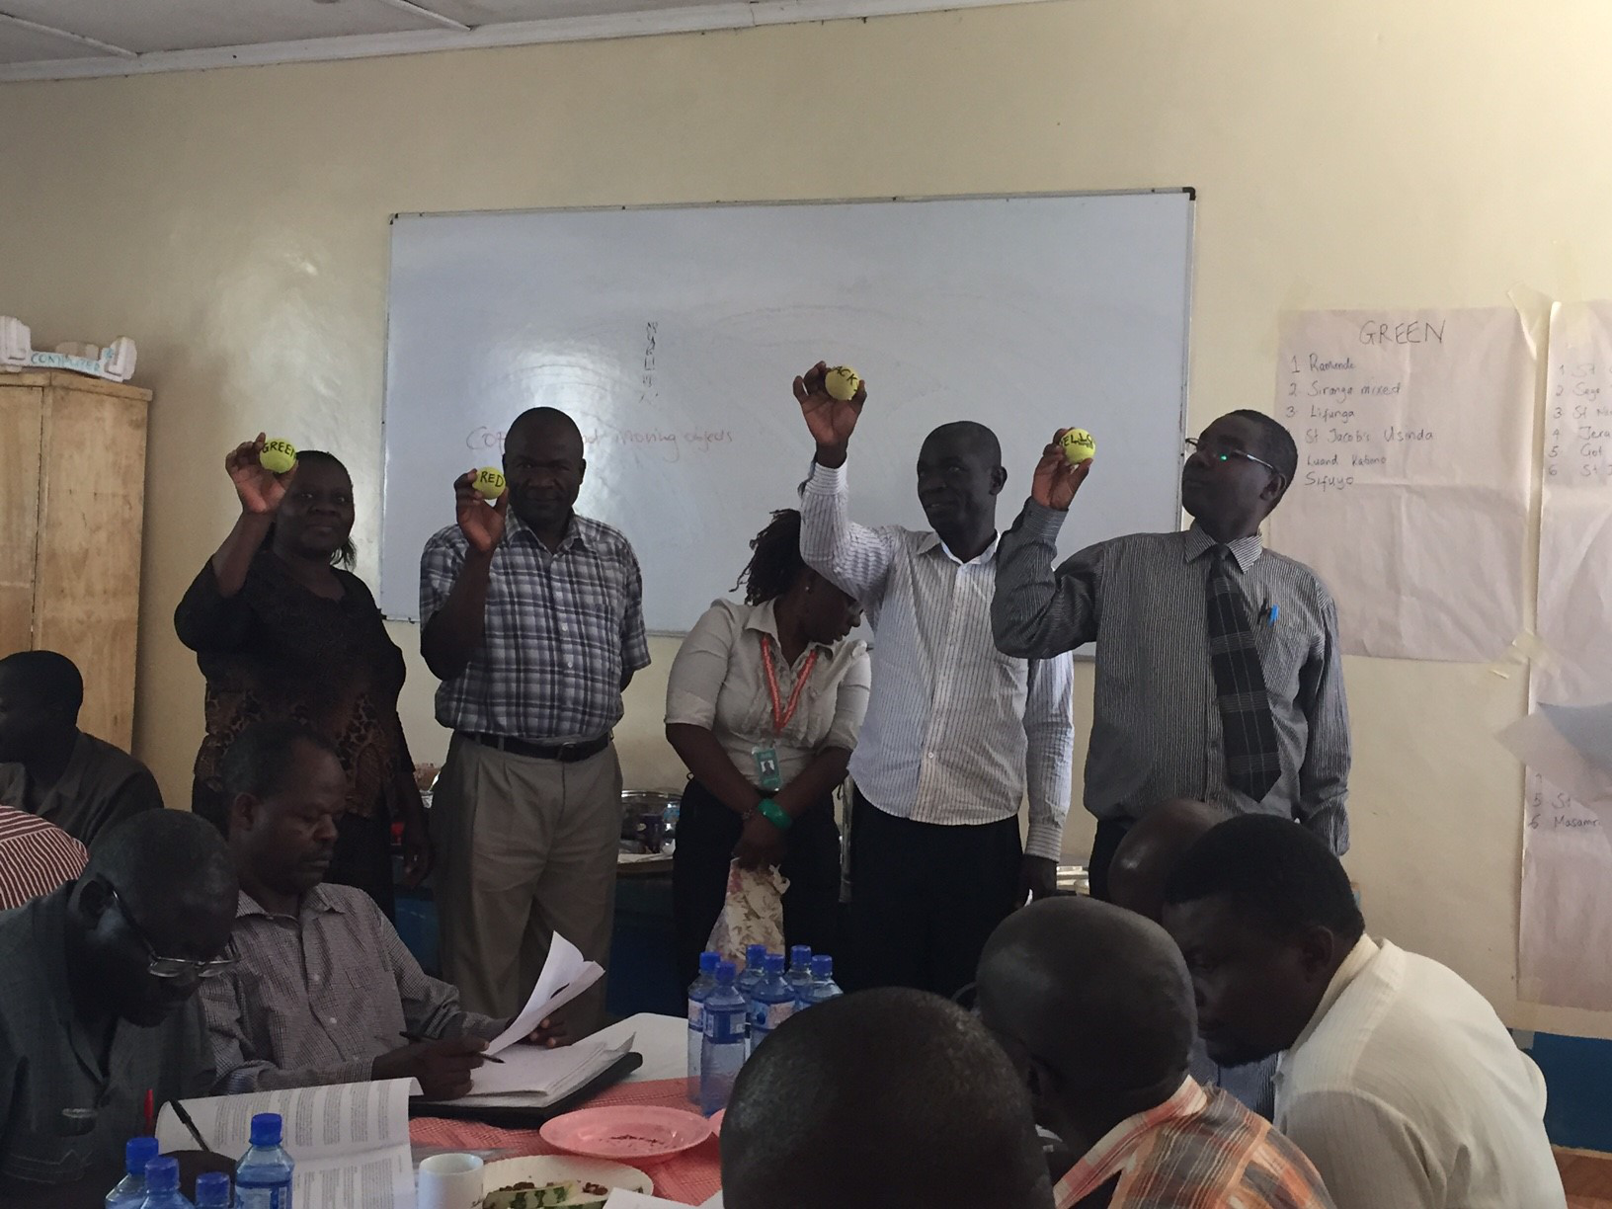
Randomization

Slide 18
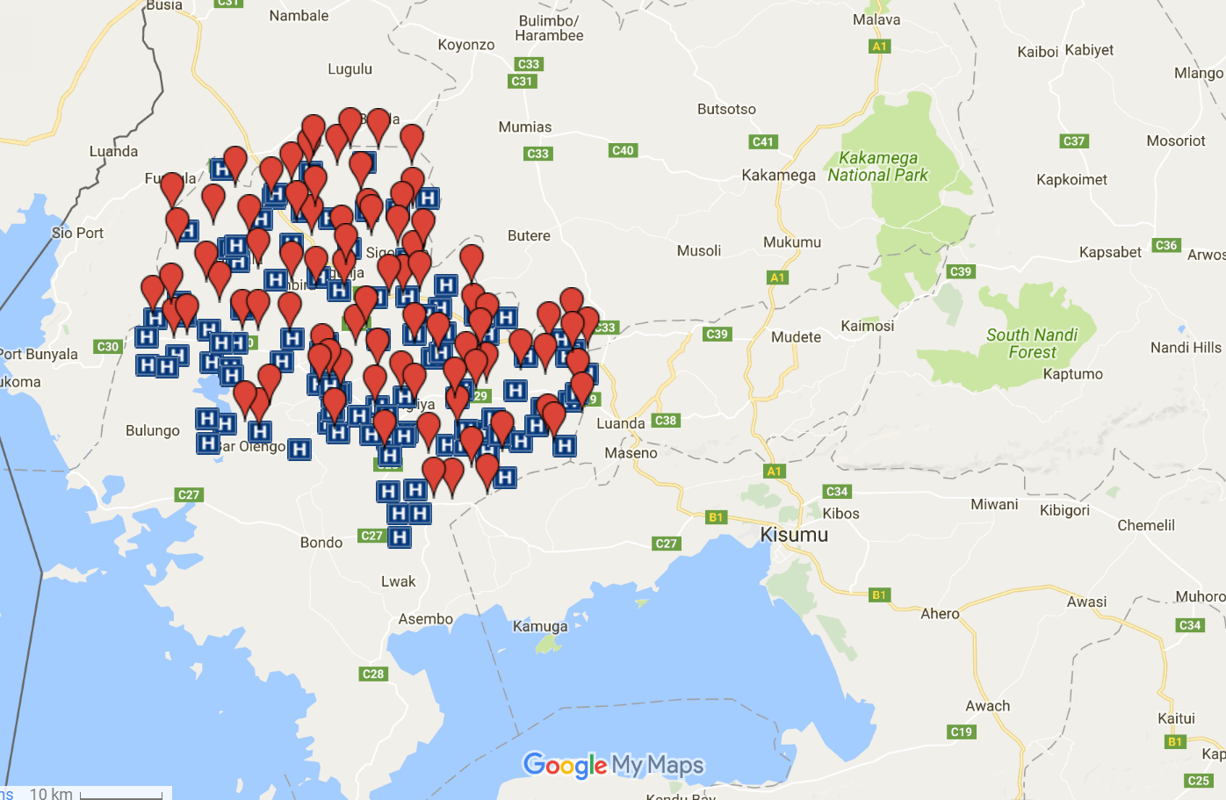
Study area (2000km²)

Slide 19
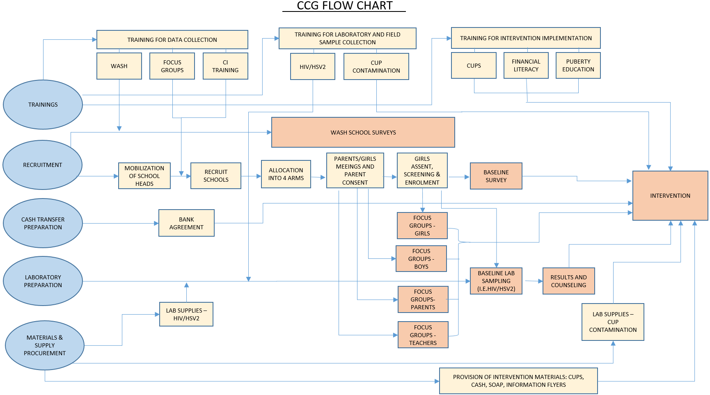

Slide 20
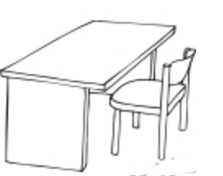
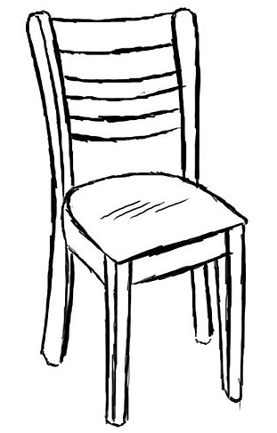
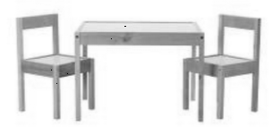

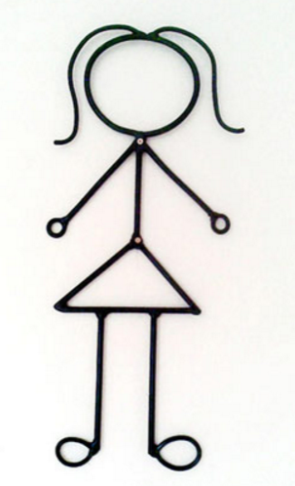
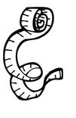
Health Day Activity Diagram
Last sample drop off for lab 3:00pm
QUEUE
STATION 1
ASSENT
STATION 2
BASELINE SURVEY
STATION 3
HIV TESTING AND COUNSELING
STATION 4 (OPTIONAL) ANTHROPOMETRIC MEASURES
Each assent takes approximately 20 minutes
Each desk can do 3 per hour
Each baseline survey takes approximately 60 minutes
Each tablet can do 1 per hour
Each HIV counseling and blood draw takes approximately 30 minutes (post group sensitization)
Each desk can do 2 per hour
Each height and weight measurement takes approximately 6 minutes
Each scale can do 10 per hour

Slide 21
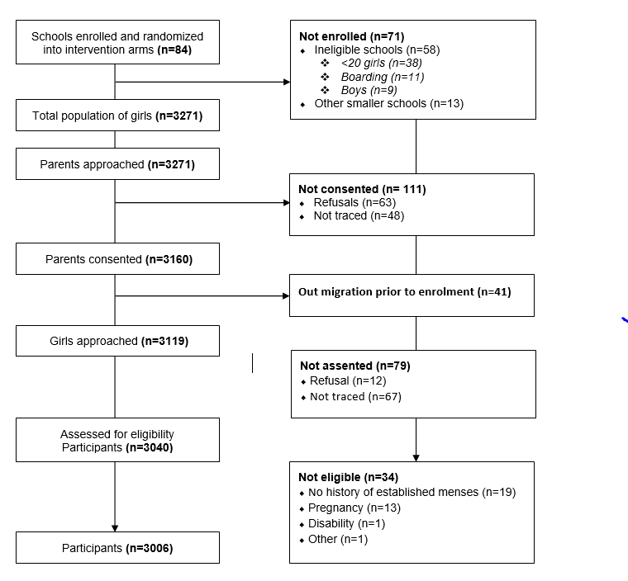

Slide 22

Thanks for listening: Q and A
Thanks to the field, office, lab teams, schools, girls, ministries, Trial Steering Committee; Data Monitoring and Ethics Committees; other stakeholder partners;
Funded by DFID/MRC/Wellcome Trust UK

Slide 23
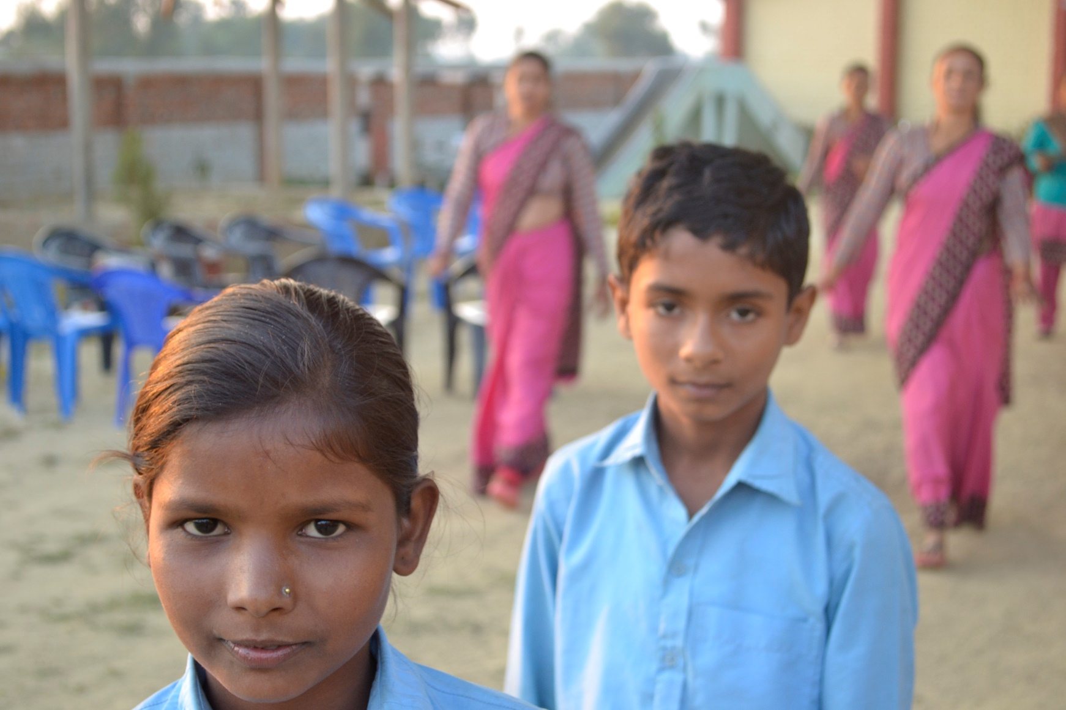

Menstrual Related: School Participation, Stress & Self-Efficacy
Jackie Haver, School Health and Nutrition Sr. Specialist
Department of Education and Child Protection
Save the Children US
Notes:
Hello, my name is Jackie Haver and I’ll be presenting for the next 20 minutes on the work Save the Children has been investing in to develop a tool that can assess Menstrual Related: School Participation, Stress, and Self Efficacy. I’d like to acknowledge that my colleague, Jeanne Long, is also on this call. Jeanne and I have been working together on MHM, and the development of the MR:SSS tool – and while I’m presenting, she has been an integral part of this process and I’d welcome her to join in to answer any questions at the end of the session.

Slide 24
AGENDA
How does MHM link to Girls’ Education
What does the literature tell us?
The process for developing Menstruation Outcome Measures
        Qualitative methods & Analysis
        Quantitative question development
        Results
    Next Steps

Slide 25
How does MHM link to Education?
In December 17, 2015, the UN General Assembly passed a resolution on water and sanitation stating that a lack of adequate WASH services, “including for menstrual hygiene management, especially in schools, contributes to reinforcing the widespread stigma associated with menstruation, negatively affecting gender equality and women’s and girls’ enjoyment of human rights, including the right to education.”
Notes:
Over the last decade, the qualitative body of evidence on MHM has grown – illustrating that girls experience restrictions with school participation, experience shame, confusion and fear at menarche, girls have reported challenges with concentration and participation when they are preoccupied, or worried, about how to manage menstruation at school. Girls have also reported fear and anxiety – and feelings of stress and self consciousness about how to manage menstruation when at school.
MHM is a human right. Surely, research is coming that will make correlations between improved MHM and other outcomes, but until then, if we care about girls' transition into adolescents, secondary schools, etc, we should consider the right to manage one's menstruation similarly to the right to water and sanitation.
The UN general assembly recently passed a resolution stating that a lack of WASH services.... INCLUDING MHM negatively affects girls and womens human rights – including the right to education

Slide 26
MHM and Education
What about Attendance?
  In Bangladesh girls were more likely to miss school during menstruation if they believed that their menstrual problems impacted their performance in school, attended schools that had locked toilets, or faced restrictions during menstruation (Alam et al., 2017).
  In rural Malawi, 1/3 of girls interviewed missed at least one day of school during their last menstrual period (Grant et al., 2013).
  In Uganda, high school girls and boys missed class equally, but girls were more likely to miss school during their menstrual period (Miiro et al., 2018)
  Studies evaluating the impact of material and education provision on school attendance have yielded mixed results (Oster et al., 2011; Montgomery et al., 2012; Montgomery et al., 2016; Philipps-Howard et al., 2016).
Notes:
The challenges girls face, along with their reports that those challenges can encourage them to miss full or partial days of school, has increased an interest in identifying links between menstruation and school attendance. A cross-sectional study in Bangladesh found that girls were more likely to miss school during menstruation if they felt uncomfortable being at school during menstruation, believed that their menstrual problems impacted their performance in school, attended schools that had locked toilets, or faced restrictions during menstruation (Alam et al., 2017). A cross-sectional study in rural Malawi found that a third of girls interviewed missed at least one day of school during their last menstrual period (Grant et al., 2013). Studies evaluating the impact of material and education provision on school attendance, however, have yielded mixed results (Oster et al., 2011; Montgomery et al., 2012; Montgomery et al., 2016; Philipps-Howard et al., 2016).

Slide 27
MHM IMPACTS MORE THAN SCHOOL ATTENDANCE
  Northern Tanzania: the onset of menses restricts girls’ ability to participate in social and academic activities…They often experience shame, confusion, and fear, as a result (Sommer, 2009).
  Bolivia, Philippines & Sierra Leone: Poor MHM negatively impacts girls’ concentration and participation at school (UNICEF, Emory University, Save the Children, 2013)
  Kenya: girls described difficulties engaging in class, due to fear of smelling and leakage, and subsequent teasing (Mason et al, 2013)
  Reaching menarche in complete ignorance and in fear may weaken girls’ sense of self-confidence and competence (Williams & Currie, 2000; Short & Rosenthal (2008); Ruble & Brooks-Gunn (1982)

Slide 28
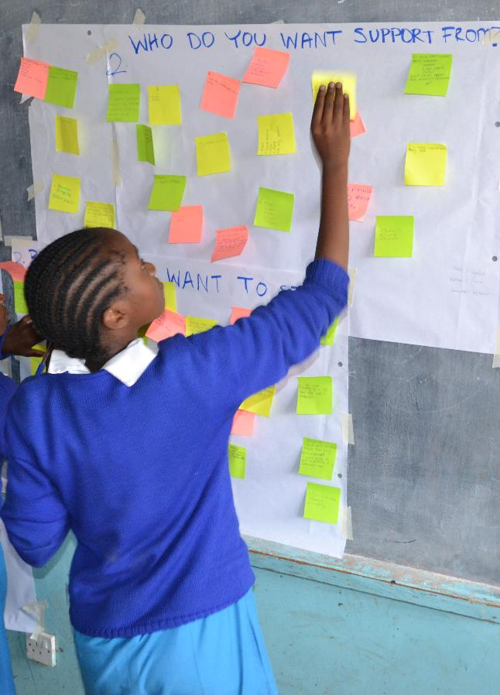
Maybe we should look beyond attendance.
Notes:
These qualitative studies, as well as the inability to find strong correlations between absenteeism and MHM, have led researchers to ask whether we should be focusing on other outcomes more closely related to the educational experiences girls have while managing their periods in school.

Slide 29
MHM Research questions
Can a
MHM program:
Increase menstruation-related
self-efficacy?
Decrease menstruation-related psychosocial stress?
Increase
School participation?
Important for behavior change
People can be given information, but unless they believe they can do something, they may not change the behavior
Girls talk about fear, embarrassment, teasing and anxiety at school related to MHM
Concentration? Answering question in class? Raising her hand? Skipping a class or parts of class?
FRESH SHN Webinar MHM in Schools
March 09 2017
Notes:
This lead Jeanne and me to develop the following research question back in 2015 – instead of "do our MHM programs reduce absenteeism among school girls, we asked:
We understood that girls who have their periods in schools cope by changing the way they interact with peers and in the classroom – raising their hands less, sitting in the back of the classroom, perhaps even missing some class so they can change their menstrual products in privacy.
Girls repeatedly talk about fear, embarrassment and confusion associate with their periods. We know that when children are stressed, they cannot learn as well.
Lastly, we know that before someone can change behavior they have to believe in their ability to do that. So an MHM program should be able to increase self-efficacy (like confidence) so that girls are able to manage their periods better.

Slide 30
Can we develop accurate measures for menstruation-related school participation, stress and self-efficacy?
Notes:
The problem is that these measures don't exist and they are concepts that likely one cannot measure with one question.
It would be as if we wanted to take someone’s temperature, but the instrument to assess temperature, the thermometer, did not exist.
So we started on a journey to see if we could develop questions them. I’m now going to focus on the process to develop the Menstrual Related – School Participation, Stress and Self-Efficacy tool, more affectionately short-formed as the MR-SSS tool.

Slide 31
Phases of MR:SSS Tool Development
Menstrual Related: School Participation, Stress and Self Efficacy
Phase I
Phase II
Phase III
Phase IV
Qualitative Research in El Salvador and The Philippines
Analysis and
MR-SSS tool development
MR-SSS pilot in El Salvador and tool revision
Revised MR-SSS and protocol in The Philippines
May – Nov 2016
Data collection:
Sept – Dec 2016
Analysis of deductive codes and constructs:
Item and Survey Development:
Oct 2016 –Feb 2017
MR-SSS pilot:
Exploratory Analysis:
May –Nov 2017
Revised MR-SSS tool and protocol:
MR-SSS pilot:
Girls
boys
parents
teachers
200 girls
13 rural schools
Grades 6-8
47 survey questions
School Participation
Stress
Self-efficacy
Focus group discussions
In-depth interviews
Participatory learning activities
Internal consistency
Mokken scaling
Principle components
Exploratory factor analysis
enumerator training
Back translation
Pre-testing and terminology revision
First MR-SSS tool
86 survey questions
Notes:
The development of the Menstrual Related – School Participation, Stress and Self-Efficacy (MR-SSS) tool has consisted of four phases, including (1) qualitative data collection, (2) qualitative analysis to inform the quantitative tool development, (3) tool piloting and analysis of pilot results to improve the tool and (4) a second pilot in the Philippines with the updated tool.

Slide 32
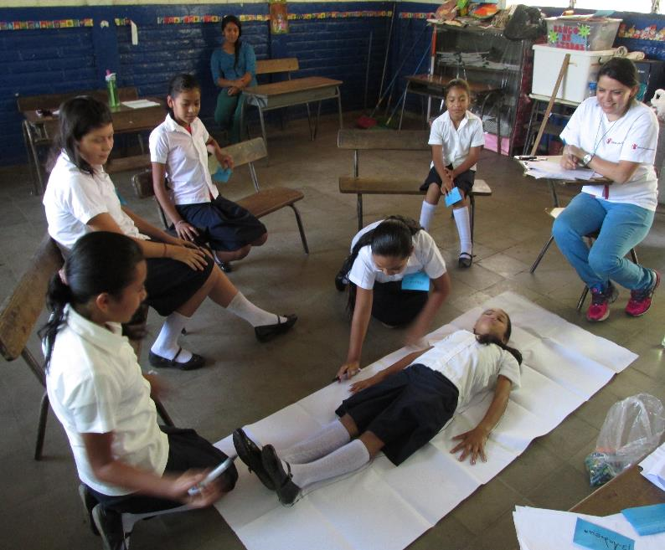
Phases of MR:SSS Tool Development
Menstrual Related: School Participation, Stress and Self Efficacy
Phase I
Qualitative Research in El Salvador and The Philippines
May – Nov 2016
Data collection:
Girls
boys
parents
teachers
Focus group discussions
In-depth interviews
Participatory learning activities
Body mapping - Girls drew a heart and a brain and talked about the difference between feelings and emotions
Timeline of their school day - that was used as a contrast to think about how their day might be different, or not, when they had their period.
Notes:
Phase 1 aimed to understand how girls in El Salvador and in The Philippines experienced and described school participation, stress and self-efficacy in regard to menstruation. In both locations, between May and November of 2016, Save the Children staff and Columbia University Fellows utilized qualitative methods, including participatory learning activities (PLA), in-depth interviews (IDIs), focus group discussions (FGDs) and Key Informant Interviews (KII). Mothers, father, teachers, and girls and boys in grades 5 through 7 were engaged in discussions regarding girls’ typical worries managing their menses in school (stress), how their behavior in class or with peers changed on those days (school participation), and the abilities girls believed they had to solve these challenges (self-efficacy). Qualitative tools were initially the same for each country, and were iteratively adapted in each location.
Pictured is an example of the participatory learning activities. Girls in El Salvador conduct a body mapping activity to talk about the difference between feelings and emotions. Girls also drew a timeline of their school day to think about how their day may be different, or the same, when they had their period.
PLAs:
Body mapping - Girls drew a heart and a brain and talked about the difference between feelings and emotions
Brainstorming in pairs - worries that girls had in school with their period
Use of "thermometer" to rank the worries and discuss them
Timeline of their school day - that was used as a contrast to think about how their day might be different, or not, when they had their period.
Call-in radio advice line - scenario

Slide 33
Phases of MR:SSS Tool Development
Menstrual Related: School Participation, Stress and Self Efficacy
Then let’s suppose that in the morning you got your period. Do you think you’ll have the same result on your test?
“In my case, it affects me…I feel bored, strange and I don’t feel like studying, but I do what’s possible and I study but there are times when I forget things and I don’t know why”
The last three times I had my period…
I had a difficult time concentrating in class
I did not feel like doing my homework
Phase II
Analysis and
MR-SSS tool development
Survey questions
Qual Question
Girl’s response
Sept – Dec 2016
Analysis of deductive codes and constructs:
Item and Survey Development:
School Participation
Stress
Self-efficacy
Apr- Aug 2016
Sept-Oct 2016
Nov 2016
Jan 2017
Jul 2017
First MR-SSS tool
86 survey questions
Notes:
In Phase 2, qualitative data was transcribed verbatim and analyzed using MAX QDA. The domains of interest were coded, and then each domain was analyzed separately to understand the various facets that defined school participation, stress and self-efficacy for girls. Using the findings from each domain, including many direct quotes, to develop survey questions. The tools were separately developed for the Philippines and El Salvador, including 20-30 close-ended survey questions per domain of interest. We then compared survey questions between El Salvador and The Philippines to add or subtract items to create one tool for both locations.
The figure with the arrow illustrates the qualitative question, the findings and an early draft version of the survey questions – we tried to use girls own words as much as possible when developing the tool.

Slide 34
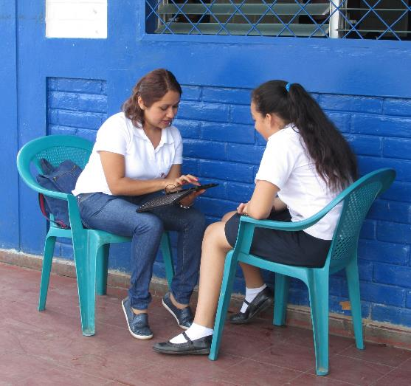
Phases of MR:SSS Tool Development
Menstrual Related: School Participation, Stress and Self Efficacy
Phase III
MR-SSS pilot in El Salvador and tool revision
Oct 2016 –Feb 2017
MR-SSS pilot:
Exploratory Analysis:
200 girls
13 rural schools
Grades 6-8
Internal consistency
Mokken scaling
Principle components
Exploratory factor analysis
Eighty-three questions were piloted
Only 7 of the participation questions met the final alpha requirement.
Notes:
In Phase III, eighty-six MR-SSS questions were piloted in El Salvador in October 2016, among 200 menstruating girls in grades 6-8, from 13 rural schools. Our research partners lead analysis; Multiple exploratory analysis were conducted to assess the reliability, validity, and utility of the initial MR-SSS scale, including: measures of internal consistency, exploratory principal components analysis, exploratory factor analysis, and exploratory Mokken scaling procedures. Exploratory analysis were inconclusive; few questions meet final inclusion criteria for any procedure. Low interrater reliability measures suggested potential challenges with the administration of the tool and format of the questions.
Results were used to refine the MR-SSS survey questions and format, as well as create an intensive enumerator training and survey protocol for subsequent surveys in the Philippines. A variation of the refined tool was also tested in Kyrgyzstan (April 2017) and Ethiopia (June 2017), though methods, translation, survey items, and oversight of data collection varied between contexts. But this helped us to further refine the tool for the Philippines pilot.
Analysis was conducted by Dr. Dreibelbis:
Alpha coefficient - until there was a set of question with an alpha close to .8- iterative process
Application of a Mokken scaling procedure
Principle components analysis

Slide 35
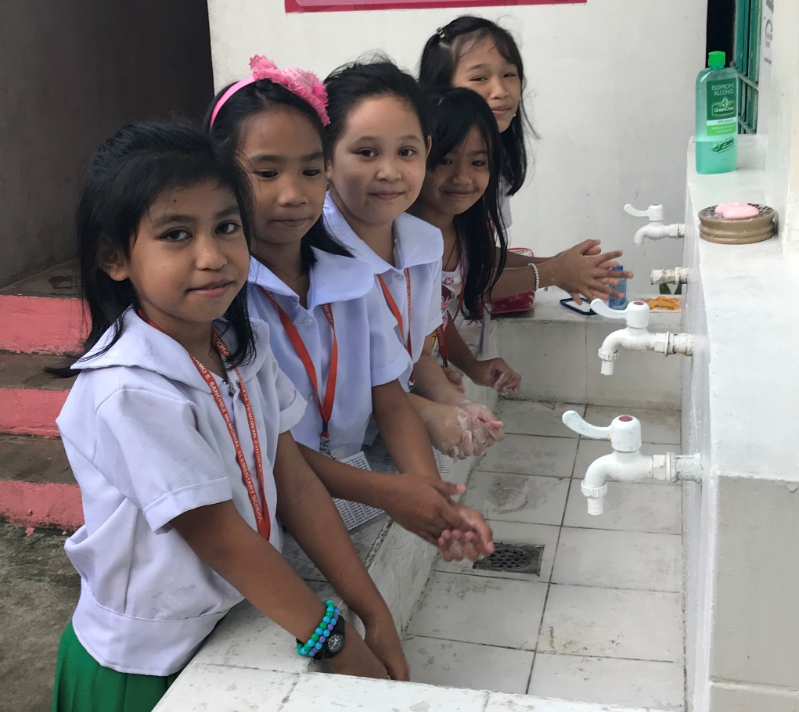
Phases of MR:SSS Tool Development
Menstrual Related: School Participation, Stress and Self Efficacy
Phase IV
Revised MR-SSS and protocol in The Philippines
May –Nov 2017
Revised MR-SSS tool and protocol:
MR-SSS pilot:
47 survey questions
enumerator training
Back translation
Pre-testing and terminology revision
6 schools in Metro Manila
645 girls sampled, 266 girls had reached menarche and answered the full survey
    301 grade 5 girls (71 reached menarche)
    344 grade 6 girls (202 reached menarche)
Notes:
Phase 4 utilized the revised MR-SSS tool, protocol, and training to conduct a pilot in the Philippines in August 2017. The revised MR-SSS tool included 13 school participation questions, 13 stress questions and 21 self-efficacy questions. The tool was translated from English to Tagalog and back-translated to English. We spent a great deal of time talking through the meaning of the questions and translation of the questions with enumerators and SHN staff. We recognized that the concept of self-efficacy was quite hard to explain, or translate in a local word that was also age appropriate for grade 5 & 6 learners. Going through this process was very important for quality data collection, and to refine future trainings for administering the tool. The data from the Philippines baseline was analyzed by Dr. Robert Dreibelbis at LSHTM. Robert settled on a one factor analysis after trying multi-factor analysis and Mokken Scaling – but Robert can better answer analysis questions related to method, so happy to forward any questions on to him after the webinar.

Slide 36
Philippines MR:SSS Assessment Findings
Notes:
And that takes us to the Philippines findings. We are please to share that the two plus years of development has been positive – and that we have the development of a scale.
We have the start of a scale – measuring social support components of self efficacy
Cluster of questions that are about achieving a negotiation about receiving something from another person – social support as part of SE

Slide 37
MR-SSS Assessment Findings: School Participation
Factor Loadings and Unique Variances
Item Description | Factor 1 | Uniqueness
P4: …you preferred to spend recess alone… | 0.4222 | 0.8218
P5: …you didn’t feel like doing your homework… | 0.5324 | 0.7165
P6: …you didn’t feel like doing anything… | 0.5033 | 0.7467
P7: …when the teacher asked you to go to the board, you asked to be excused from it… | 0.4128 | 0.8296
P9: …you missed a day of school… | 0.4016 | 0.8387
P10: …you had a difficult time concentrating in class… | 0.5138 | 0.7360
P12: …you had a difficulty paying attention to the teacher because you were thinking about your period… | 0.6523 | 0.5745
P13: …you didn’t answer the teachers question even though you knew the correct answer… | 0.4262 | 0.8183
Cronbach’s Alpha | 0.7146
Notes:
On the slide is a table that shows the Participation questions, factor loadings and their uniqueness. The Factor loadings are how correlated specific response patterns are to the underlying factor. The Cronbach’s alpha was 0.7146, for pilot work anything between 0.7 and 0.8 is considered acceptable.
In summary, we have a good start to a scale that warrants further exploration, both it terms of data collection and analytic approaches. Key participation questions to retain are: 4, 5, 6, 7, 9, 10, 12, and 13.

Slide 38
MR-SSS Assessment Findings: School Participation
Factor Loadings and Unique Variances
Item Description | Factor 1 | Uniqueness
P4: …you preferred to spend recess alone… | 0.4222 | 0.8218
P5: …you didn’t feel like doing your homework… | 0.5324 | 0.7165
P6: …you didn’t feel like doing anything… | 0.5033 | 0.7467
P7: …when the teacher asked you to go to the board, you asked to be excused from it… | 0.4128 | 0.8296
P9: …you missed a day of school… | 0.4016 | 0.8387
P10: …you had a difficult time concentrating in class… | 0.5138 | 0.7360
P12: …you had a difficulty paying attention to the teacher because you were thinking about your period… | 0.6523 | 0.5745
P13: …you didn’t answer the teachers question even though you knew the correct answer… | 0.4262 | 0.8183
Cronbach’s Alpha | 0.7146
Notes:
On the slide is a table that shows the Participation questions, factor loadings and their uniqueness. The Factor loadings are how correlated specific response patterns are to the underlying factor. The Cronbach’s alpha was 0.7146, for pilot work anything between 0.7 and 0.8 is considered acceptable.
In summary, we have a good start to a scale that warrants further exploration, both it terms of data collection and analytic approaches. Key participation questions to retain are: 4, 5, 6, 7, 9, 10, 12, and 13.

Slide 39
MR-SSS Assessment Findings: Stress
Factor Loadings and Unique Variances
Item Description | Factor 1 | Uniqueness
S2: …did you worry about your period starting at school… | 0.5458 | 0.7021
S3: …were you afraid that boy classmates would make fun of you | 0.4619 | 0.7867
S4: …were you afraid that girl classmates would gossip about you | 0.5574 | 0.6893
S5: …did you feel nervous… | 0.4805 | 0.7691
S6: …did you worry that it would be painful… | 0.5754 | 0.6690
S7: …were you afraid that you would accidentally do something that would make your period worse… | 0.4374 | 0.8087
S8: …did you worry that you would stain your school uniform… | 0.5199 | 0.7297
S9: …did you worry about using the school toilet… | 0.4566 | 0.7915
S10: …did you worry about having enough water to use in the toilet… | 0.4424 | 0.8042
S11: …did you worry about how you would dispose of your pad at school… | 0.4614 | 0.7871
S12: …did you worry that boys may peek on you when using the toilet… | 0.5739 | 0.6707
Cronbach’s Alpha | 0.7924
Notes:
This slide shows the Stress questions, factor loadings and their uniqueness. The Cronbach’s alpha for stress was 0.7924 (for pilot work anything between 0.7 and 0.8 is considered acceptable). While we had a total of 13 stress questions, these 10 questions were the questions that loaded.

Slide 40
MR-SSS Assessment Findings: Self-Efficacy
Factor Loadings and Unique Variances
Item Description | Factor 1 | Uniqueness
SE3: …you are confident that you can ask a friend for help… | 0.5376 | 0.7110
SE4: …you are confident that you can ask the teacher for a pad if you need one… | 0.5727 | 0.6720
SE5: …you are confident that you can get a pad if you need one… | 0.4448 | 0.8022
SE6: …you are confident that you could ask a friend to lend you a pad… | 0.5029 | 0.7471
SE12: …you are confident that you could talk to an adult if you have questions about your period… | 0.4796 | 0.7700
SE13: … you are confident that you could ask the teacher for help if you stain yourself… | 0.5196 | 0.7300
SE15: … you are confident that you can ask the teacher for pain medication if you need it… | 0.4499 | 0.7976
SE16: … you are confident that you can manage your ‘hot headed’ feelings… | 0.4424 | 0.8043
SE19: …you are confident that you could report students who bully you about menstruation to the teachers… | 0.4007 | 0.8394
SE20: …you are confident that you can stand up for yourself if you are teased about menstruation at school… | 0.5220 | 0.7275
Cronbach’s Alpha | 0.7632
Notes:
This slide shows the Self Efficacy questions, factor loadings and their uniqueness. The Cronbach’s alpha for the Self Efficacy questions was 0.7632 (for pilot work anything between 0.7 and 0.8 is considered acceptable).
For the self efficacy questions, we are starting to realize that we have not measured self-efficacy, but rather social support. These questions are about confidence in getting something from another person.

Slide 41
Lessons Learned & Next Steps

Slide 42
What We’ve Learned Thus Far
Enumerators/staff administering the tool must be adequately trained.
Emic terms and tailoring the survey for a context/to each girl is helpful.
Tool may be age-sensitive
School participation, stress and self-efficacy are not independent domains.
Needed academic partners’ guidance
Notes:
those administering the tool in the field NEED a clear understanding of the questions and survey protocol, and an introduction to the menstrual health field and awareness of the overall objective of the work.
In the Philippines, the details we added to the training and protocols motivated enumerators to collect high-quality data, as they understood their valued contribution to the innovation and its implications beyond the Philippines.
training and clear understanding of the tool matters. In comparison to countries that could not afford the time, a longer training period in the Philippines resulted in greater buy-in and understanding of the MR-SSS tool concepts
improved administration of the tool. Moving forward, we recommend more enumerator engagement and interaction with the tools during the training.
Important for our team to be able to tailor the survey as appropriate. Not all girls use the same words to describe menses or their menstrual materials, which may also vary between disposable and reusable products. Our team used Kobo (electronic data collection tools) that could be customized based on emic terminology. Early in the assessment girls were asked their preferred term for menstruation. The enumerators then were prompted to enter this term into the tool, and the assessment form was automatically updated to use the girl’s preferred term throughout the survey. This not only made girls feel more comfortable and eased their ability to answer the survey questions, but it also eased the burden of the enumerator to remember their word of choice.
MR-SSS measurement tool is likely age-sensitive. A comparison of basic descriptive statistics across countries that collected MR-SSS data suggests that the tool and the domains we were attempting to capture may be more relevant for younger girls. Older schoolgirls have more experience managing their menses in school, their menstrual periods may be more regular and more of their friends have reached menarche, potentially creating additional social support. Thus, older girls may not experience the same levels of stress or lack of self-efficacy as younger girls just beginning to transition into puberty and dealing with these changes for the first time. Our tool will be able to determine if there are in fact differences. Future assessments will recruit girls by age and not grade, as age-for-grade varies significantly across contexts. This key finding has corresponding policy and implementation implications, MHM programming in schools should target girls by a certain age and not grade, to reach them with pertinent information before menarche.
school participation, stress and self-efficacy are not independent domains, but overlap with one another. For example, when a girl has her period in school, she can be stressed about standing up in the classroom (stress and school participation domains) or she may not feel confident she can perform well no an exam that day because of her period (self-efficacy and school participation domains). Attempting to create consistently separate domains was important for the purposes of analysis, though not necessarily representative of the reality of girls.

Slide 43
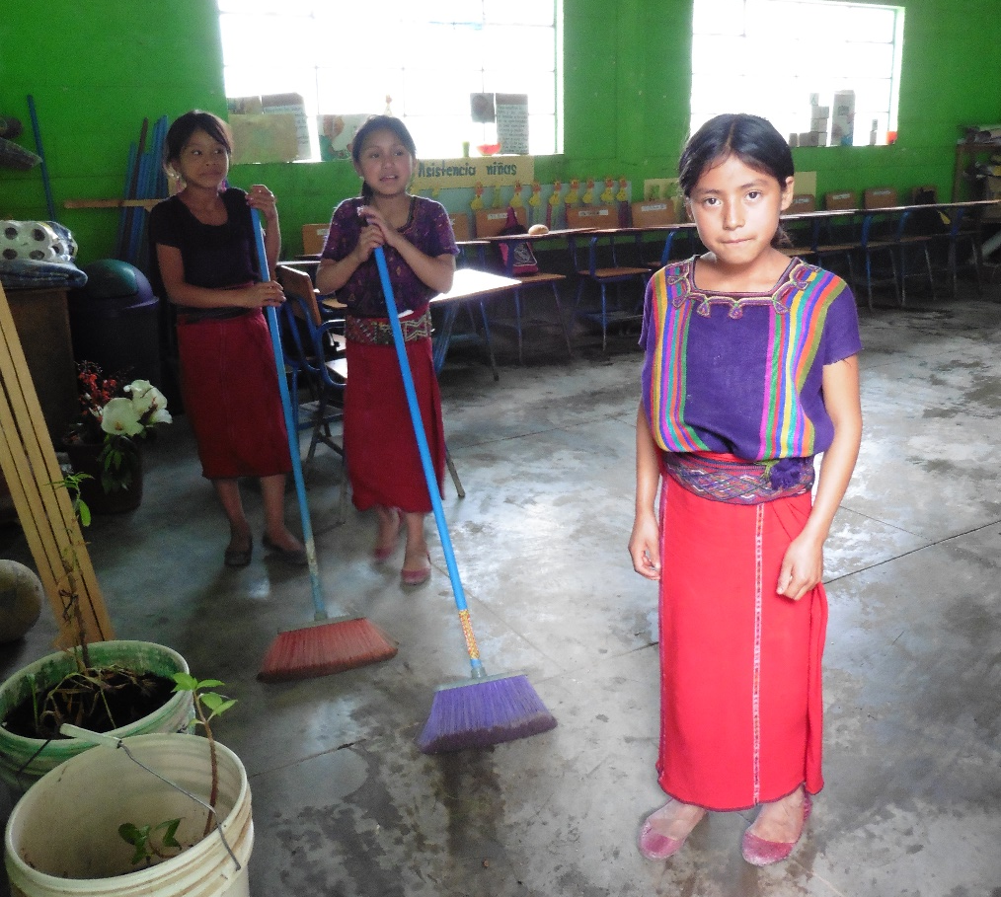
Next Steps
Add in non-MHM related measures to test our theory
    More gender norms questions
    Education support indices and/or general social support
    Learning assessments (reading comprehension or math skills)
Notes:
Add in other non MHM related measurements – education participation indices or general social support – we want to see a strong correlation between social support SE and general SE
Our theory is based on formative research and the voices of girls we work with. Another step in understanding how MHM affects educational experiences would be to know whether our MHM measures correlate with other outcomes that exist – such as reading or social support.

Slide 44
Next Steps
  Can the MR:SSS tool measure change in stress, school participation and self-efficacy over time?
  How does the MR:SSS tool measure these domains in different countries and contexts?
Philippines endline
Mexico baseline and endline
Kyrgyzstan endline
Nepal
baseline
Indonesia baseline
Summer 2018
Fall 2018
Spring 2019
Notes:
Add in other non MHM related measurements – education participation indices or general social support – we want to see a strong correlation between social support SE and general SE
Our theory is based on formative research and the voices of girls we work with. Another step in understanding how MHM affects educational experiences would be to know whether our MHM measures correlate with other outcomes that exist – such as reading or social support.
Need to find more funding opportunities for both tool development and developing evidence based MHM programming. Need $$$ to fund tool use and intervention.
Philippines - Administer tool Fall 2018 after girls and boys have had a full year of programming (some of the same cohort)
Nepal – Administer tool Summer 2018 (new girls)
Indonesia and Mexico - Administer tool Fall 2018 (new girls)
Kyrgyzstan – endline Spring 2019

Slide 45
Credits
Save the Children
Jeanne Long, Senior Specialist SHN
El Salvador
Margarita Franco, Director of Program Quality
Mario Alvarado, MEAL Specialist
Beatriz Huezo, SHN Coordinator
Philippines
Jonathan Valdez, WASH Advisor
Jelly San Buenaventura, Program Officer
Research Fellows:
Chiara Bercu, Columbia University
Nelly Maina, Columbia University
Research Partners:
Dr. Bethany Caruso, Emory University
Dr. Robert Dreibelbis, London School of Tropical Hygiene and Medicine.

