Slide 1
FRESH School Health & Nutrition Webinar:
Eye Health Promotion in Schools – Components and Costs
17th September 2018

Slide 2
Intersectionality of health & education
Address factors determine whether child:
  Starts school
  Stays in school
  Learns in school
Example: impact of vision on learning
  80% of learning is visual
  10% of students in primary school in developing countries have poor vision

Slide 3
Uncorrected refractive error is leading cause of poor vision
Supply
Human resources
Diagnostic equipment
Spectacles
Demand
Awareness of benefits
Stigma
Financial
Cost of services + spectacles
Competing priorities

Slide 4
Response: school screening programs
Uncoordinated
Ad hoc
Non-standardized
Lack of sustainability

Slide 5
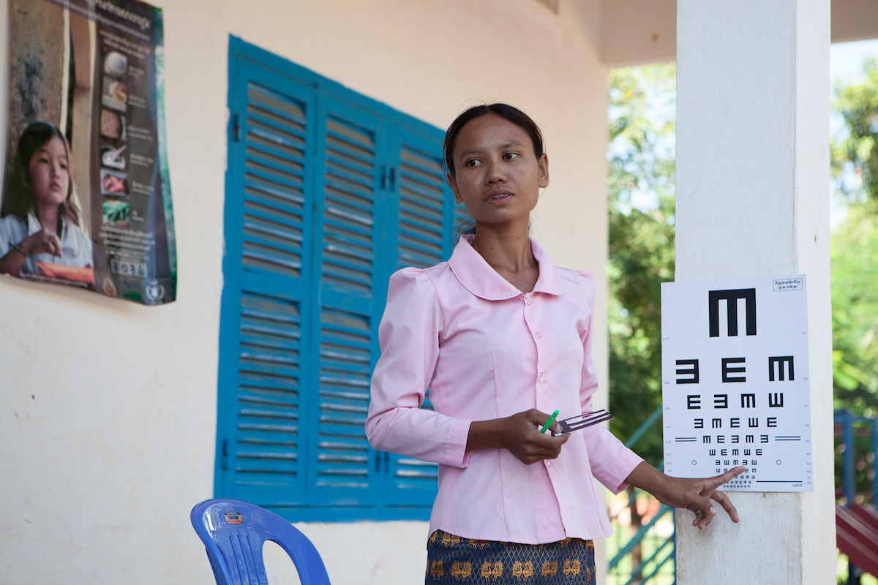
School Health Integrated Programming (SHIP)
Developed & implemented by Sightsavers & Partnership for Child Development (PCD) with supervision and funding from GPE through the World Bank
Aims:
  Schools as a platform to deliver health interventions using deworming and vision screening as entry points
  Raise awareness, capacity and engagement among governments towards comprehensive School Health & Nutrition (SHN)
  Create a foundation by which countries would have the awareness, capacity, and the operational and technical resources to include SHN into their Education Sector Plans (ESP)

Slide 6
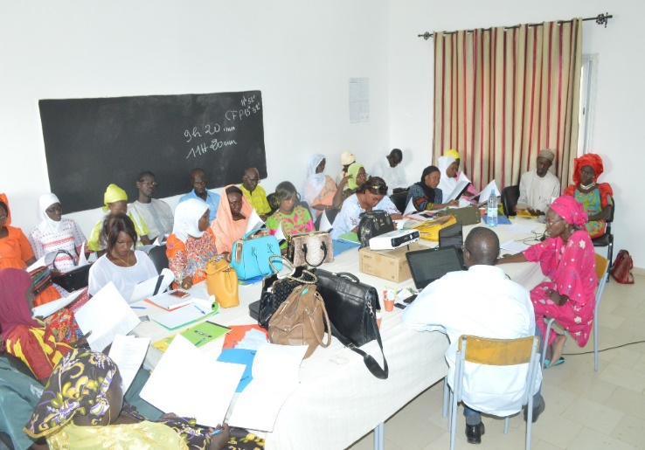
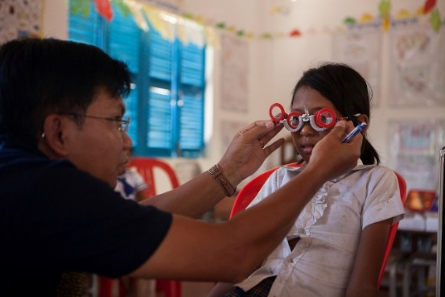

Slide 7





SHIP Standardized Approach
Simplified vision screener
Integrated health interventions
Standardized guidelines
Ready-to-clip spectacles

Slide 8

SHIP results
Model piloted in 4 countries: Cambodia, Ethiopia, Ghana, Senegal
Capacity building workshops conducted bringing MOE & MOE together
Operational & technical guidelines developed
Pilot interventions:
476 teachers trained in 158 schools
57,434 children vision screened
47,106 dewormed
1,017 were given glasses (1.7% prevalence)

Slide 9

Conclusions: foundation for integration of SHN programmes into education policy & planning
Schools: effective platform for health delivery
Collaboration between MOE & MOE vital
Integrated school-level activities must be easy for teachers to implement
Align with existing policies, systems & infrastructure to support ownership & sustainability

Slide 10
Costing study background
  Aim
  Generate evidence on the cost of including vision screening in integrated school health programmes (based on SHIP project)
Research questions
  What is the cost of a school-based eye health program?
  How were these expenditures distributed?
  What would be funding requirements for conducting vision screening as part of an integrated school health program at national level?
  Settings
  Ghana and Cambodia

Slide 11
Methods
Analysis
Actual costs
  Incremental analysis for vision screening (SHIP project)
  Cash expenditure only (not economic costs)
  In-country costs
Standard costs
  Based on SHIP guidelines for conducting school-based eye health programmes.
  Unit costs derived from project actual expenditures
  In-country expenditure only
Budget Impact Analysis
  Resources required for scaling up school-based vision screening at national level (Government perspective)
  Based on standard costs
  Projection scenario (targeting children in primary/secondary schools):
    Year 1: screening all children in primary and lower secondary
    Year 2: screening only new entrants+ children who received glasses
    Year 3: screening new entrants children in primary and all children in secondary

Slide 12
Methods
Costing approach
Actual costs Based on a review of cash expenditures linked to implementation of SHIP project (including expenditures covered by SHIP budget and by implementing partners)
Program planning and management Activities conducted for all 4 countries prior or in support of the implementation phase |  | Implementation phase Review of cash expenditure linked to activities implemented as part of pilots conducted in each country
 |  | Setup costs Investment required at start of vision screening program | Recurrent costs Activities to be implemented on an annual basis
Standard costs
Based on SHIP project expenditures
Costing tool
Using education and financial data
Budget Impact Analysis
Based on SHIP guidelines and country-specific intervention scenarios

Slide 13
Methods
Breakdown by activities and sub-activities
Planning, management & support
Scoping mission
Stakeholder sensitization/Engagement with LEG
Development of operational guidance and material for training
Operational & technical support
Grant management
Set-up cost
Capacity building and partnership strengthening (workshop)
Training of trainers
Training of teachers
Program implementation
Coordination
Sensitization/social mobilization
Vision screening by school teachers
Eye examination by mobile team
Referral to clinics (transportation)
Supervision
Follow-up intervention

Slide 14
Methods
Breakdown by inputs
Venue rental, catering, and other expenses
  Catering, rental equipment and venue hire
Personnel
  Per diem, consultant and trainer fees, salaries, accommodation, meals and drinks
Transportation
  Fares (taxi, bus etc.), fuel, vehicle hire, flights, driver per diem, vehicle maintenance and others (tolls, parking fees etc.)
  Equipment (useful life>1yr)
  Ready-to-clip or customized spectacles
Materials and supplies
  Medical supplies (drugs and consumables), Office stationary, supplies and reprography, Promotional & IEC materials,
Services
  Communication (mobile phone credit), Financial and accounting services, Media, Translation

Slide 15
Results – SHIP actual expenditure in Cambodia
Implementation phase – Breakdown by activity

Slide 16
Results – SHIP actual expenditure in Ghana
Implementation phase – Breakdown by activity

Slide 17
Results – SHIP actual expenditure
Implementation phase – Breakdown by inputs
Cambodia
Ghana

Slide 18
Results – SHIP actual expenditure
Implementation Phase - Cost drivers in Cambodia and Ghana
Activity\inputs | Personnel | Transportation | Venue rental and catering | Services | Material and supplies | Spectacles | Grand Total
Training of teachers | 12.3% | 4.0% | 8.5% | 0.1% | 0.9% | - | 25.7%
Coordination | 22.0% | 0.3% | 0.1% | 0.3% | 2.4% | - | 25.0%
Capacity and partnership strengthening (workshop) | 13.3% | 1.1% | 1.0% | 0.6% | 0.1% | - | 16.0%
Eye examination (failed screening) | 10.8% | 0.9% | - | - | 0.4% | 1.0% | 13.0%
Supervision | 5.6% | 1.4% | - | - | - | - | 7.0%
Training of trainers | 2.5% | 1.2% | 0.8% | - | - | - | 4.5%
Follow-up intervention | 2.5% | 0.5% | - | - | - | - | 3.0%
Sensitisation/social mobilisation | 1.0% | - | 1.8% | - | 0.2% | - | 2.9%
Vision screening at school | - | - | - | - | 1.9% | - | 1.9%
Referral at eye clinic | - | 1.0% | - | - | - | - | 1.0%
Grand total | 69.9% | 10.4% | 12.1% | 0.9% | 5.8% | 1.0% | 100%
47.6%

Slide 19
Results – SHIP actual expenditure
Unit costs from actual expenditure (in USD 2016)*
Activity | Output | Cambodia |  | Ghana
 |  | Count (N) | Unit cost (USD) | Count (N) | Unit cost (USD)
Training | Trainers trained | - | - | 20 | 674
 | Teachers trained | 126 | 186 | 120 | 112
Vision screening and correction of refractive error | School screened | 48 | 748 | 60 | 499
 | Children screened | 12,440 | 2.9 | 10,099 | 3.0
 | Children examined | 214 | 168 | 2138 | 14
 | Children with corrected RE | 72 | 499 | 74 | 404
* Excluding program planning & management and other pilot specific expenditures
Notes:
Cost by activity and inputs similar in both countries due to standard procedure but…
Context-specific differences
Higher daily cost of the refraction mobile team in Cambodia
Costs of custom-made spectacles higher in Ghana
Different salary levels, per diem rates, accommodation or equipment costs (The results show the importance of using context-specific expenditure information when planning and budgeting interventions at scale.)
^{Notes:}
ª The unit costs presented in this table are calculated by dividing the activity total cost by the number of units for different outputs. Total training costs amounted to $23,384 in Cambodia and $13,485 in Ghana. Vision screening and correction of refractive error (provision of spectacles) activities amounted to $35,898 in Cambodia and 29,933 in Ghana.
^{b} No trainers’ training necessary in Cambodia
^{c} Unit cost per child reflects the high number children referred by teachers to the mobile refraction team in Ghana compared to Cambodia (due to a higher prevalence of eye conditions but also higher false positive rate for children referred by teachers)

Slide 20
Results – Standard SHIP expenditure
Standard unit costs estimation (used for budget projection)
Item | Unit | Cambodia Unit cost (in USD 2016) | Ghana Unit cost (in USD 2016)
Capacity and partnership strengthening
Workshop | Per participant per day | 76 | 396
Training
Training of trainers | Per trainer | 438 | 459
Training of teachers | Per teacher | 93 | 72
Community sensitisation
 | Per district | 76 | 79
 | Per region | 218 | 210
Vision screening, eye examination and treatment/referral
Vision screening kit | Per screening kit | 3.9 | 4
Mobile refraction team | Per day | 315 | 255
Ready-made spectacle | Per spectacles | 2 | 2
Customized spectacle | Per spectacles | 6.4 | 25
Transportation allowance | Per child referred | 20 | 21
Coordination, supervision and M&E
Coordination expenses per year (at national level) | Per year | 10,296 | 38,400
Coordination expenses per year per region | Per year per region | 13,310 | 28,738
Notes:
(a) Cost include costs for radio messages, posters, and other activities for reaching out of school children and building awareness amongst school and community on eye health
(b) One kit per school, screening kit for teachers includes a vision screener for three meters (6/9 optotype), three meter rope and record forms
(c) Based on project actuals expenditure per day worked
(d) Ready-to-clip spectacles used in SHIP were donated by Essilor; spectacles can be purchased for a unit price of 2USD
(e) Personnel involved in eye health program as per SHIP guidelines: one program manager and one technical manager (at central level), and one coordinator per administrative unit (either province or region)

Slide 21
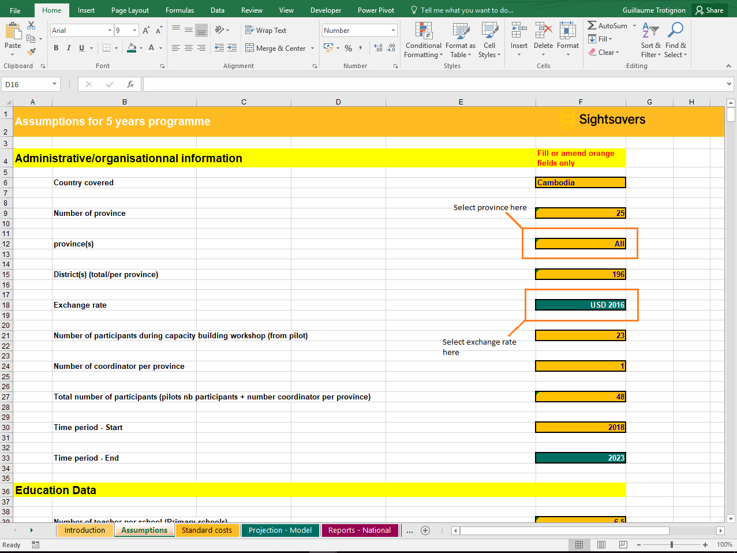
Costing tool – Brief introduction
Assumptions
Standard costs
Education data
Projection model
Report
Assumptions (e.g.)
  Cost of school-based vision screening in Primary school and/or lower secondary school (Children aged 6 to 14 years)
  Financial data from SHIP pilots
  Percentage if already made and custom-made spectacles based on data from SHIP pilots

Slide 22
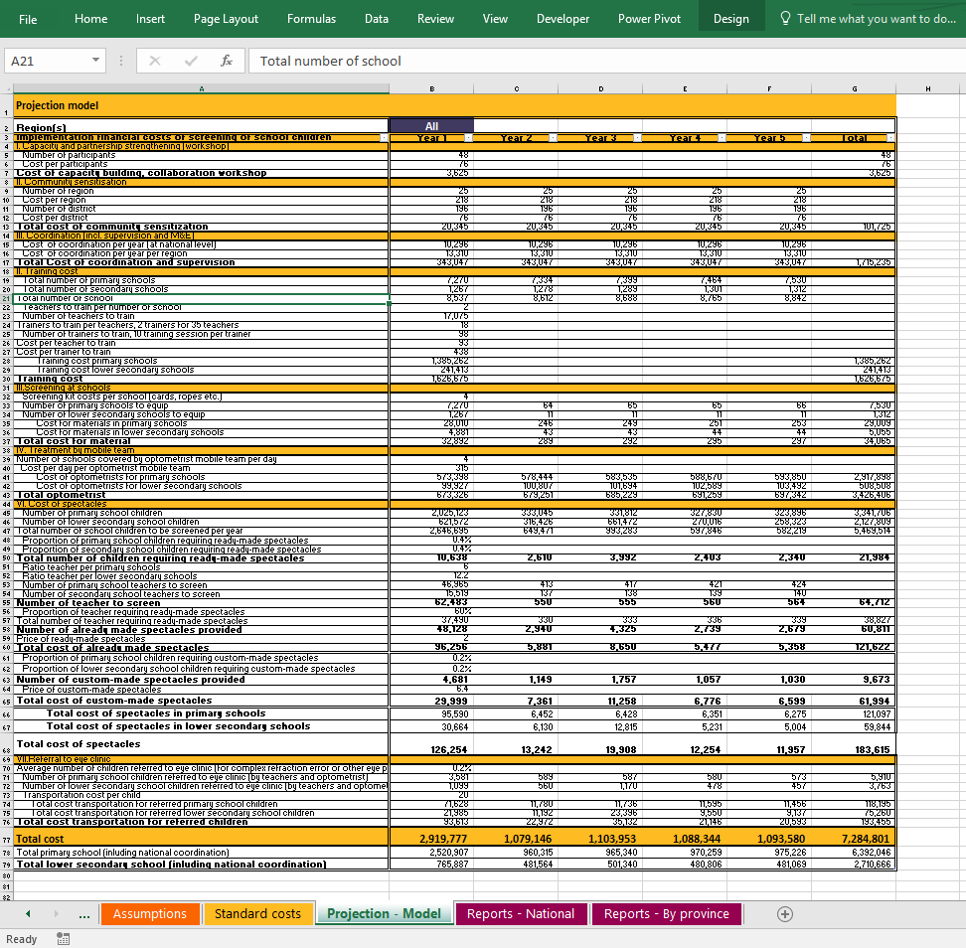
Costing tool - Brief introduction
  Standard activities developed through SHIP
  Standard costs identified in pilot countries
  Model based on existing literature (Baltussen et al., 2009; Baltussen et al. 2012)
  Year 1: Most prohibitive due to high set-up costs
  Following years expected to be less prohibitive
  National school-based vision screening programmes in Cambodia and Ghana were $7,285,244 and $16,706,133 over five years (2019-2023)

Slide 23
Results cost projection
Cost effectiveness
  Projected cost per child screened, $1.33 in Cambodia and $1.84 in Ghana
  Projected cost per child with corrected refractive error; $230 in Cambodia and $238 in Ghana
  Use of teachers for conducting vision screening is essential ($500 in Cambodia and $549 in Ghana if screening of school children was done by mobile refraction teams only)
Notes:
Cost per child screened, $1.33 in Cambodia and $1.84 in Ghana projected instead of 2.9 and 3.0 for actual expenditure.
Cost per child with corrected refractive error; $230 in Cambodia and $238 in Ghana instead of 499 and 404 for actual expenditure
It is difficult to place our estimates and projections in the context of other studies, as evidence on cost of school-based vision screening is scarce and the differences in methodological approaches of the few studies available limit opportunities for meaningful comparisons. In addition, this analysis did not aim to calculate the number of DALYs averted by correction of RE. Therefore, at this stage it is not possible to do a comparison with the WHO cost-effectiveness thresholds (Marseille et al., 2015) or cost per DALY presented in earlier studies (Baltussen, Naus & Limburg, 2009; Baltussen & Smith 2012).

Slide 24
Results costing study
Cost savings
  Ready-made spectacles provided on site should be prioritised, as it can generate substantial savings ($2 vs $6.5 in Cambodia and $2 vs $25 in Ghana)
  Screening and distributing spectacles to the teachers is important can maximise the benefits of the programme
  Economies of scale: By implementing these programmes at national level - Reducing start-up cost (mostly fixed); Integrated health services using schools as platforms to deliver eye health services to out-of-school children to increase the number of beneficiaries
  Considering that teacher training and coordination constituted a significant part of the overall budget, potential economies of scope in integrating vision screening with other school-based interventions (DCP 3; Fernandes & Aurino, 2017).
Notes:
Firstly, the majority of children with RE identified by the SHIP project were eligible for ready-made spectacles. Considering the price difference between ready-made and custom-made spectacles ($2 vs $6.5 in Cambodia and $2 vs $25 in Ghana), the use of ready-made spectacles provided on site should be prioritised, as it can generate substantial savings. Secondly, the use of teachers for conducting vision screening is essential, as it significantly reduces the cost of the overall programme (Keeffe 2013; SHIP 2017). Based on our findings, we estimated that the cost per child treated for RE would rise more than two-fold to $500 in Cambodia and $549 in Ghana if screening of school children was done by mobile refraction teams only. Thirdly, the recommendation from the SHIP guidelines to screen and distribute spectacles to the teachers is important and, although it may represent an additional cost, can maximise the benefits of the programme. Children often refuse to wear spectacles for a variety of reasons including: no perceived benefit, parental disapproval, and fear of being teased (Smith et al., 2016).

Slide 25
Results costing study
Affordability
Cambodia
  National Budget Law for 2018: $485million for the health and $848million for the education sector (Nary, 2017; Sokhean, 2017; Sophirom, 2017).
  Budget for five-year vision screening programme represents 1.5% of the current health budget, 0.9% of the education budget and 0.5% of the combined (health and education) budget ($1.333billion).
Ghana
Total government budget for 2018 : $991million for health and $2.074billion for education (MOF, 2017).
  The estimated total vision screening budget represents 1.7% of the health budget, 0.8% of the education budget and 0.5% of the combined budget ($3.065billion).
Notes:
Year 1 would correspond to 0.2% of combined annual budget (Cambodia and Ghana) and following years 0.08% of combined annual budget (in Cambodia and Ghana)
One of the main purposes of conducting a budget impact analysis is to assess the affordability of a new intervention in a specific setting. The total budgets required to implement the national school-based vision screening programmes in Cambodia and Ghana were $7,285,244 and $16,706,133 over five years (2019-2023) respectively. It is important to put the projected budget estimates in the perspective of the education and health sector financing in each country, as implementation and funding for school-based health and nutrition programmes typically involves (but is not limited to) these two ministries.
In Cambodia, the National Budget Law for 2018 was adopted for a total amount of $6.018billion, including $485million for the health and $848million for the education sector (Nary, 2017; Sokhean, 2017; Sophirom, 2017). The total budget estimated for implementing the five-year vision screening programme ($7,285,244) hence represents 1.5% of the current health budget, 0.9% of the education budget and 0.5% of the combined (health and education) budget ($1.333billion). The funding need for the vision screening programme will be the highest in the first year ($2,919,843) representing about 0.2% of the combined annual budget (0.6% of health and 0.3% of education sector budget). For the following years, the maximum annual budget of $1,104,041 would constitute 0.08% of the combined annual budget, assuming the government allocations in the next five years are similar to 2018.
In Ghana, the total government budget for 2018 is equivalent to US$15,074billion; including $991million for health and $2.074billion for education (MOF, 2017). The estimated total (five year) vision screening budget ($16,706,133) would represent 1.7% of the health budget, 0.8% of the education budget and 0.5% of the combined budget ($3.065billion). Assuming that the government budget remains constant in the coming years, the first year of the programme ($7,288,381) would amount to 0.2% of the combined budget (0.7% of health and 0.4% of education). For the following four years, the highest budget required per year would be $2,488,328 or 0.08% of the combined annual budget (0.25% of health and 0.12% of education budget).
When considering the governments’ current budgets for health and education sectors in Cambodia and Ghana, the implementation of a national school-based vision screening programme appears to be affordable in both countries. However, more detailed information on the breakdown of these budgets by programmes and cost type would be required. Also, information on the specific budgets allocated to different departments involved in the implementation of the school-based screening would need to be considered. Given that a set-up of such programmes would require substantial investments to be made in the first year of the project, support from external donors may be required to cover start-up costs in the first year, while government funding could be used to cover recurrent expenditures of the programme annually.

Slide 26
Learnings
The results show the importance of using context-specific expenditure information when planning and budgeting interventions at scale.
The costing tool could help policy-makers and planners to identify cost drivers
Results confirm that vision screening of schoolchildren (DCP 3, 2017) is a cost-effective way to identify and treat children with visual impairments.
Study suggested that integrating vision screening with other school-based interventions and delivering this at scale can maximize both the economies of scale and economies of scope.
The analysis shows that the scale up of the programmes in Ghana and Cambodia is affordable
Notes:
The results show the importance of using context-specific expenditure information (salary levels, price level, equipment availability, etc.) when planning and budgeting interventions at scale.
The costing tool could help policy-makers and planners to identify cost drivers, to minimize, and, potentially, to include school based vision screening into sector planning
Results confirm that vision screening of schoolchildren (DCP 3, 2017), as part of a school-based health package, is a cost-effective way to identify and treat children with visual impairments.
Study suggested that integrating vision screening with other school-based interventions identified in the essential package of school age child health and delivering this at scale can maximize both the economies of scale and economies of scope.
The analysis shows that the scale up of the programmes in Ghana and Cambodia is affordable, if the costs are shared between the health and education budgets

Slide 27
Thank you
Email: imkhan@sightsavers.org gtrotignon@sightsavers.org
Visit: sightsavers.org
sightsavers.org

Slide 28
References
Baltussen R, Naus J, Limburg H. 2009. Cost-effectiveness of screening and correcting refractive errors in school children in Africa, Asia, America and Europe. Health Policy 89(2): 201-215.
Baltussen R, Smith A. 2012. Cost effectiveness of strategies to combat vision and hearing loss in sub-Saharan Africa and South East Asia: mathematical modelling study. British Medical Journal 344
Fernandes M, Aurino E. 2017. Identifying an Essential Package for School-Age Child Health: Economic Analysis. In: Bundy D (ed). Disease Control Priorities, Third Edition (Volume 8): Child and Adolescent Health and Development, Washington DC: World Bank, 355-368.
Ministry of Finance (MOF), Republic of Ghana. 2017. The budget statement and economic policy of the Government of Ghana for 2018 financial year. Accra, Ghana.
Nary L. 2017. National Assembly Approves National Budget Law 2018 [Online]. Phnom Penh: Agence Kampuchea Presse. Available at: http://www.akp.gov.kh/archives/115007 (Accessed: 30th July 2018).
Sokhean B. 2017. Government proposes $6B budget for 2018 [Online]. The Phnom Penh Post. Available at: http://uat.phnompenhpost.com (Accessed: 30th July 2018)

